Slide 1



Slide 2
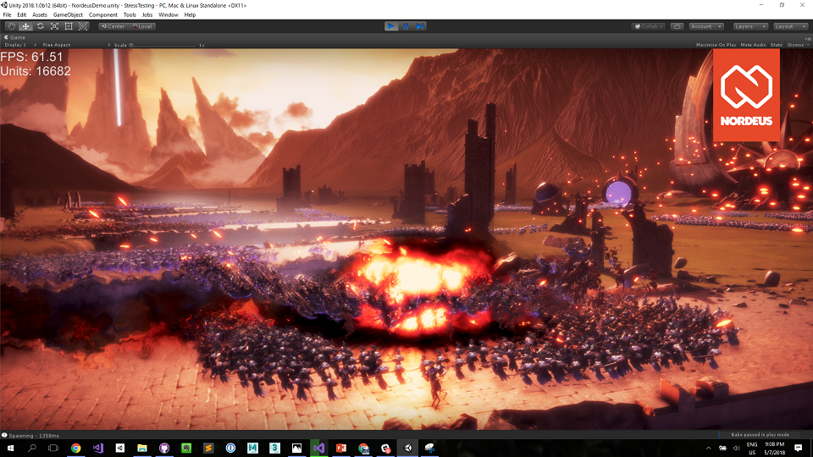

Slide 3
ECS

Slide 4
Arturo Nereu @ArturoNereu - arturo@unity3d.com

Slide 5
ECS

Slide 6
Entity

Slide 7
Component

Slide 8
System

Slide 9
What do we want to achieve?
Notes:
What problem are we trying to solve?
Why are we doing this?

Slide 10
Performance
by default
Notes:
We want to write game code that is as performant as possible.
We want games to run faster
We want games to have more enemies
We want phones that generate less heat
We want less battery consumption.

Slide 11

Notes:
What is Unity doing?
We are always improving the engine. We are jobifying or engine. Updating our frameworks, etc.
We want to give you the most performant engine we can. But also, from your side, a paradigm shift is needed. What shift? …. ECS

Slide 12
ECS

Slide 13
Entity

Slide 14
Component

Slide 15
System

Slide 16
How do we code today?
Notes:
How do we program, how we were taught and how we have been doing it for years?

Slide 17
C
Notes:
Have you used C? How do you use it? How do you model your data?

Slide 18
C++
Notes:
Have you used C++? Do you follow the OOP approach?

Slide 19
C#
Notes:
So, you are a Unity developer, you use C# and a mix of OOP and Component Based Programming. How do you model your objects?

Slide 20
OOP
Object Oriented Programming
Notes:
OOP stands for Object Oriented Programming, is a design pattern that models our programs based on the way we see the world.

Slide 21
Component Based
MonoBehaviour
Notes:
In Unity we use C# and so, we have the chance to use OOP, but we recommend the Component Oriented approach.

Slide 22
Object Oriented Programming
Vehicle
GroundVehicle
WaterVehicle
EngineBased
WindBased
TwoWheeled
FourWheeled

Slide 23
Component Based
GameObject
VehicleMover
VehicleProperties

Slide 24
I like it like this, what’s wrong?
Notes:
I love it this way, what is wrong?
Nothing, if it works for you, then its perfect.

Slide 25
But you are modeling the real world
Notes:
But you are modeling the real world, not precisely good for memory or for how computer Works.

Slide 26
The problem is that data is everywhere.
Notes:
Data is everywhere, more importantly, is in random locations.

Slide 27
Instantiate(minion)
Memory
Minion1
Vector3 pos;
Float speed;
Minion2
Vector3 pos;
Float speed;
Minion3
Vector3 pos;
Float speed;

Slide 28
Can’t we fix it using arrays?
Notes:
Can’t we fix it by using arrays?

Slide 29
Memory
Minion1
Vector3 pos;
Float speed;
Minion2
Vector3 pos;
Float speed;
Minion3
Vector3 pos;
Float speed;
Notes:
Can’t we fix it by using arrays?

Slide 30
We also need a way to access data in an ordered way.
Notes:
We need a way to trasverse that data in order.

Slide 31
List<Position> List<speed>
Notes:
We need a way to trasverse that data in order.

Slide 32
DOD
Data Oriented Design
Notes:
Here comes, data oriented design.

Slide 33
Design based in data, not the real world.
Notes:
Design around data, not the real world.

Slide 34
ECS

Slide 35
Entity

Slide 36
Component

Slide 37
System

Slide 38
Entity
An Index.

Slide 39
Component
The Data Collections.

Slide 40
System
What transforms data.

Slide 41
The Vehicle Example

Slide 42
Entity
Component
System
Car1
Car2
Car3
List<Vector3>
(10, 30, 10)
(50, 100, -2)
(5, 90, 20)
Pos.x = pos.x * speed;
List<float>
5.0f
2.4f
3.5f

Slide 43
Job System

Slide 44
Lets you write simple and safe multithreaded code that interacts with the Unity Engine.

Slide 45
Job Example

Slide 46
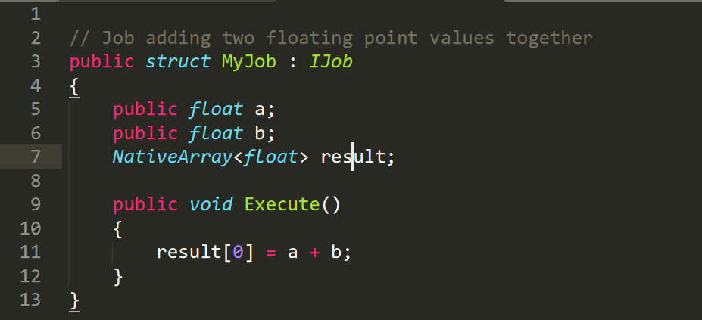

Slide 47
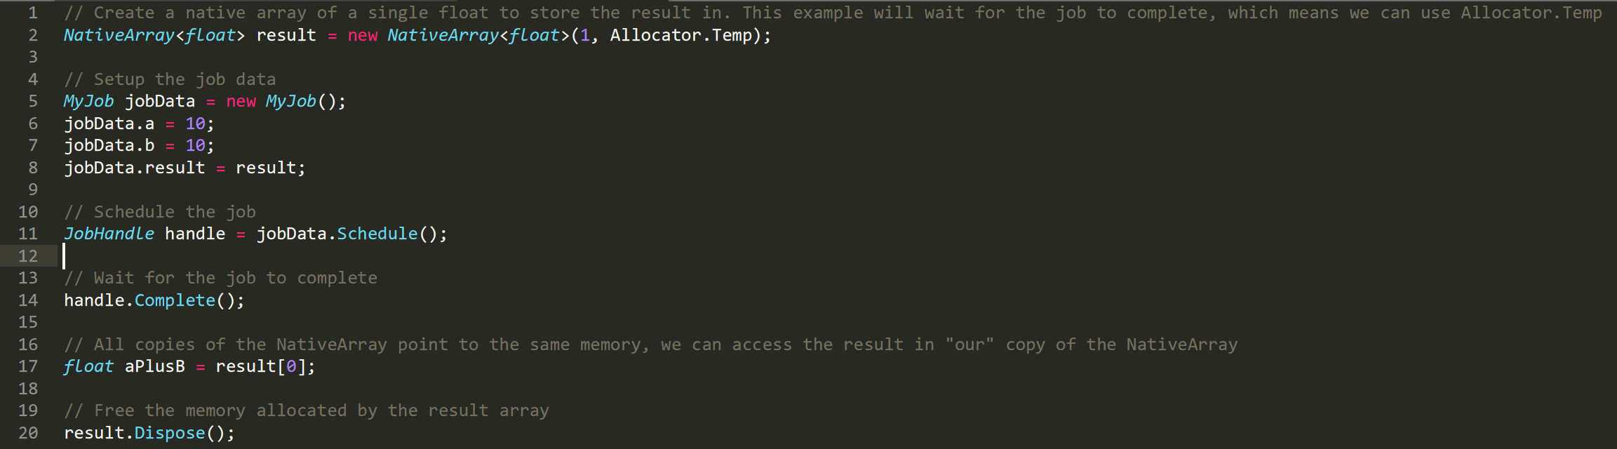

Slide 48
Job Example

Slide 49
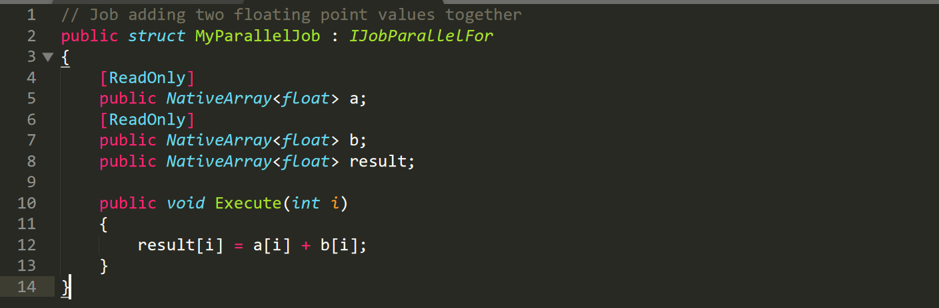

Slide 50
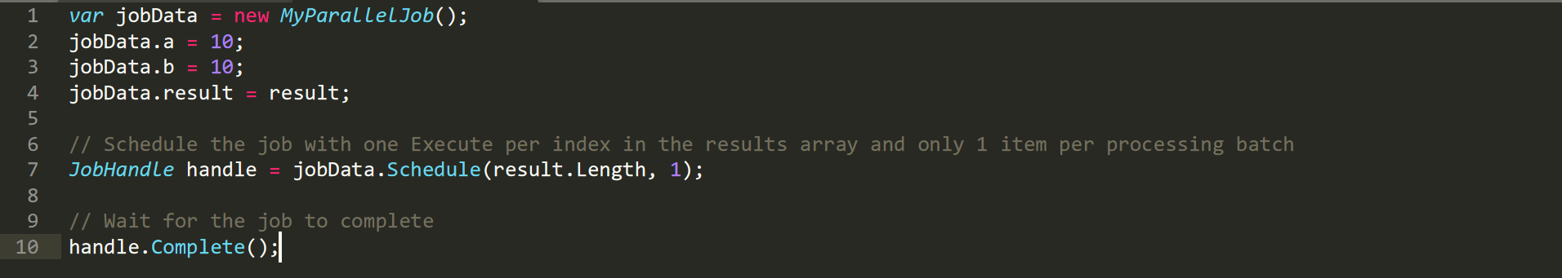

Slide 51
Burst Compiler

Slide 52
Takes C# jobs and produces highly optimized code that takes advantage of the platform you are compiling for.

Slide 53
on.unity.com/ugsea518

Slide 54
https://github.com/ArturoNereu/ECS_101

Slide 55
Thank you!

